Slide 1
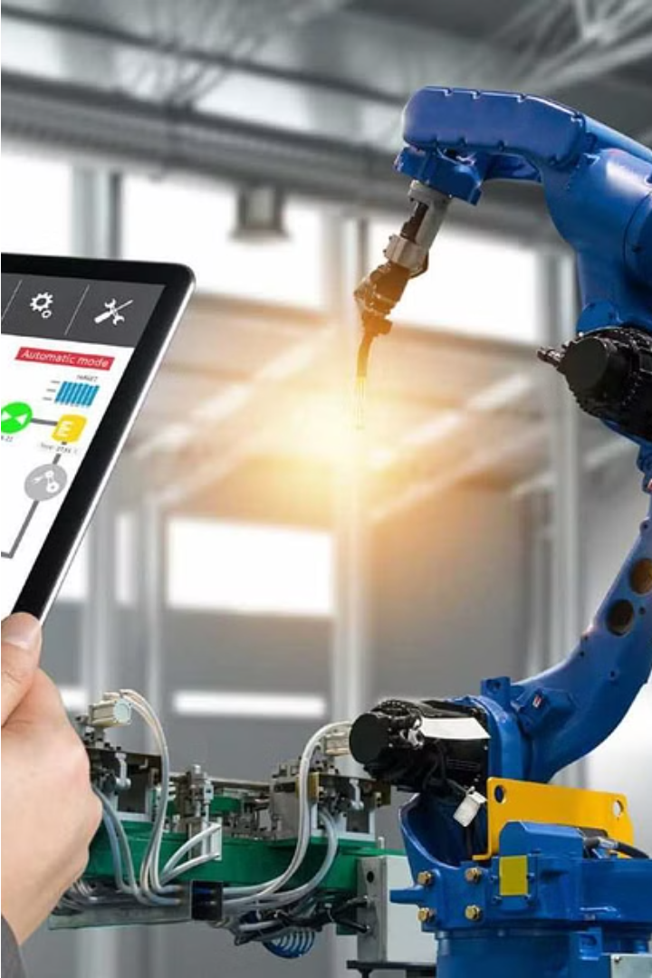
REVIEW -1
Monitoring the industrial machines
through IOT & visualization
Introduction:
the use of Industrial Internet of Things (IIoT) and data visualization to monitor and optimize industrial machinery. We'll cover the key components, working principles, and emerging trends in this transformative technology.

Slide 2
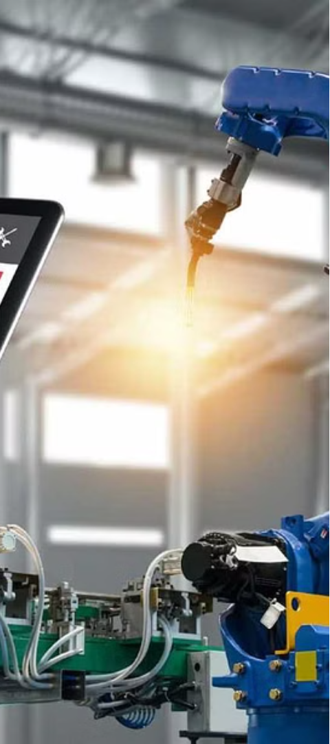
Introduction to Industrial IoT
Connecting Industrial Assets
Data-Driven Insights
By collecting and analyzing data from connected industrial assets, IIoT systems provide valuable insights to optimize efficiency, reduce downtime, and improve overall productivity.
Industrial IoT (IIoT) enables the integration of sensors, devices, and machinery within industrial environments, allowing for real-time monitoring and control of production processes.
Improved Decision-Making
IIoT empowers industrial organizations to make data-driven decisions, leading to enhanced process control, predictive maintenance, and informed strategic planning.

Slide 3
Importance of Monitoring Industrial Machines
Maximize Uptime
Optimize Efficiency
Continuous monitoring helps detect issues early, enabling timely interventions to prevent costly downtime and maintain high productivity.
Real-time data analysis uncovers opportunities to fine-tune processes, reduce energy consumption, and improve overall equipment effectiveness.
Enhance Safety
Extend Asset Lifespan
Monitoring vital machine parameters helps identify potential safety risks, allowing organizations to proactively address hazards and protect workers.
Predictive maintenance based on machine data prolongs the useful life of industrial assets, minimizing the need for costly replacements.

Slide 4
Components of Industrial IoT System
Sensors
Connectivity
Advanced sensors embedded in industrial machinery collect real-time data on performance, vibration, temperature, and other critical parameters.
Secure wireless and wired connections transmit sensor data to centralized platforms for analysis, enabling remote monitoring and control.
Analytics
Visualization
Powerful data analytics engines process the sensor data, identify patterns, and generate actionable insights to optimize operations.
Intuitive dashboards and visualization tools transform complex data into meaningful visualizations for efficient decision-making.

Slide 5




Working Principle
Data Acquisition
Data Transmission
Data Processing
Sensors embedded in industrial machines continuously measure and collect real-time data on various parameters such as temperature, vibration, and operating conditions.
The sensor data is securely transmitted to a centralized IIoT platform using wired or wireless communication protocols, such as Ethernet, Wi-Fi, or cellular networks.
The IIoT platform processes the incoming data using advanced analytics algorithms to identify patterns, detect anomalies, and generate actionable insights.

Slide 6
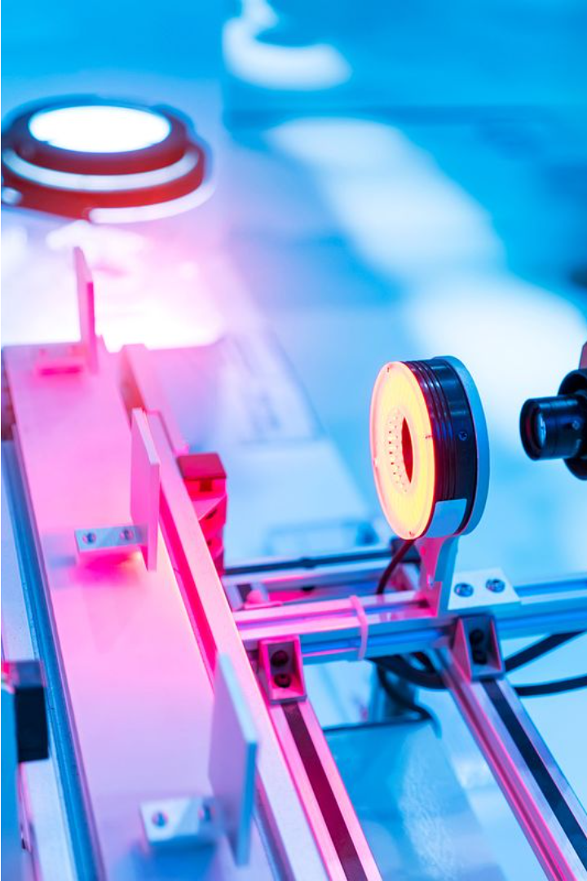
Data Collection and Transmission
Sensors strategically placed within industrial machinery continuously gather real-time data on critical parameters such as vibration, temperature, and performance. This sensor data is securely transmitted through robust wired or wireless communication protocols to a centralized IIoT platform for further analysis.
The high-speed, low-latency data transmission enables rapid data aggregation, ensuring that decision-makers have access to the most up-to-date information to optimize production processes and respond to potential issues proactively.

Slide 7
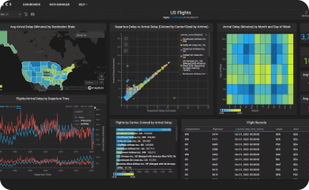
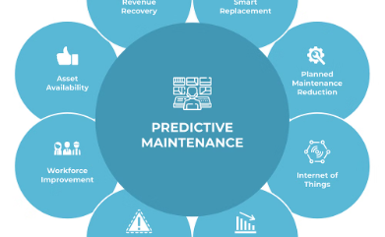
Visualization Techniques
Interactive Dashboards
Predictive Analytics
Visualizations
Data Visualization Tools
Intuitive dashboards consolidate real-time machine data, enabling operators to quickly identify performance trends, monitor critical parameters, and respond to potential issues.
Cutting-edge visualization tools transform complex industrial data into intuitive graphs, charts, and reports, empowering engineers and managers to make data-driven decisions.
Advanced data visualizations, such as trend lines and predictive models, help predict equipment failures and recommend optimal maintenance schedules to maximize uptime.

Slide 8
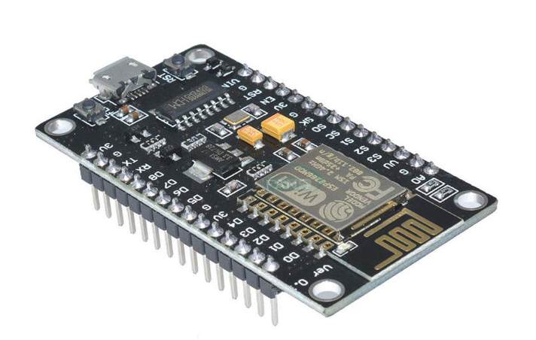
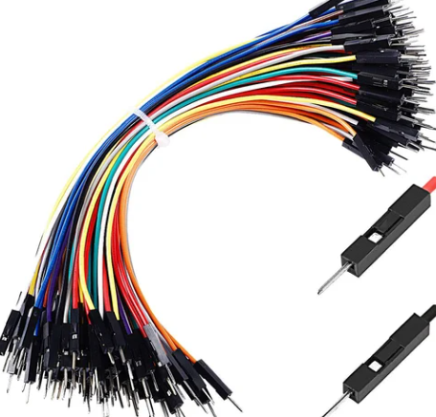
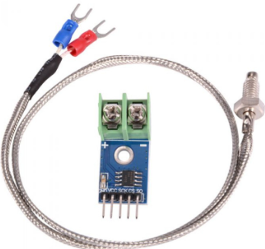
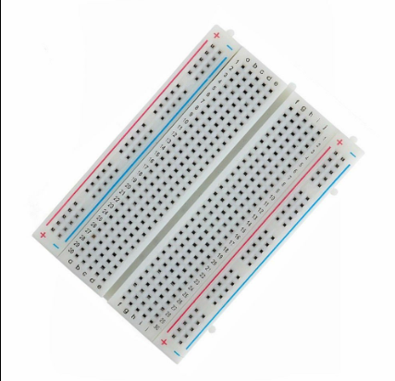
Required Components:
BREADBOARD NODE MCU CONNECTING WIRES MAX 6675 SENSOR

Slide 9
THANK YOU

